Slide 1
What is an IOA.
Indicators Of Attack
Built-in ability to create detection/prevention rules. IOAs extend the product.
Custom detection/prevention severity level
Rules can be based on process tree, domain resolution, IP, and file writes.
Rules can be used to block unwanted activity vs only blocking malicious activity. Helps enforce acceptable use policy.

Slide 2

IOA Evolution
IOA Lifecycle at Mars.
1
2
Think of the IOA
Deploy the IOA
4
3
Is it needed anymore?
Tune the IOA

Slide 3
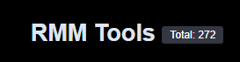
IOA: RMM Abuse
The double-edged sword of Remote Monitoring and Management software
https://lolrmm.io
RMM Issues:
Administrators: Need efficient, consistent host monitoring and management; RMM provides solutions.
Threat Actors: EDR advancements challenge their C2 tools and access; RMM offers alternative solutions.
Risk: Compromised RMM software, due to its trusted status, poses a significant security risk. CrowdStrike reported a 70% increase in adversary use in 2024.
Tips: Approve an RMM solution, inventory software, use strong passwords and a vault, identify shadow IT, and audit RMM usage.
Threat Actors can leverage RMM for:
Privilege Escalation: Compromised RMM tools grant threat actors elevated administrative access, allowing them to execute commands and scripts with significant control over an organization's IT infrastructure.
Stealthy Lateral Movement: RMM's legitimate remote access capabilities enable attackers to move undetected across networks, bypassing detection from unusual remote service use. This also offers a persistence option.
Widespread Malware Distribution: Threat actors can leverage RMM's trusted deployment channel to discreetly distribute malware, like ransomware, to many endpoints simultaneously. However, EDR solutions can still prevent or detect such deployments.

Slide 4
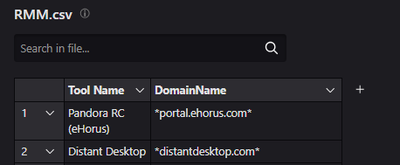
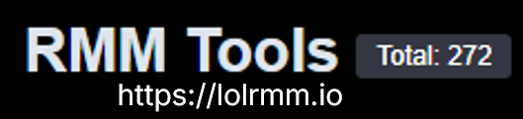
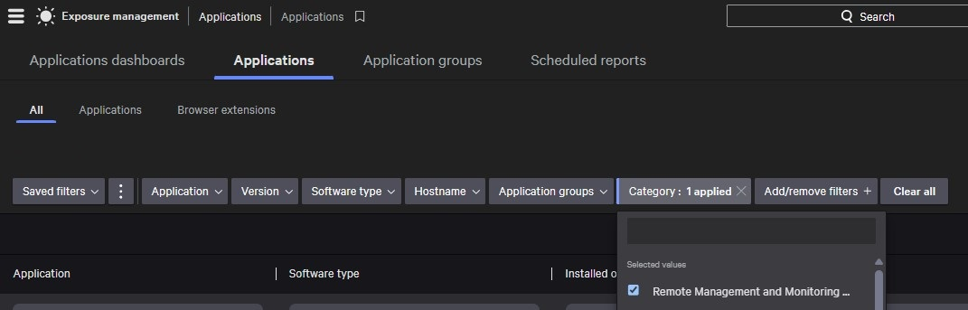
Hunting
Query: #event_simpleName=DnsRequest
|match(file="RMM.csv", field=[DomainName], mode=glob)
|groupBy([ComputerName,"Tool Name",DomainName])

Slide 5
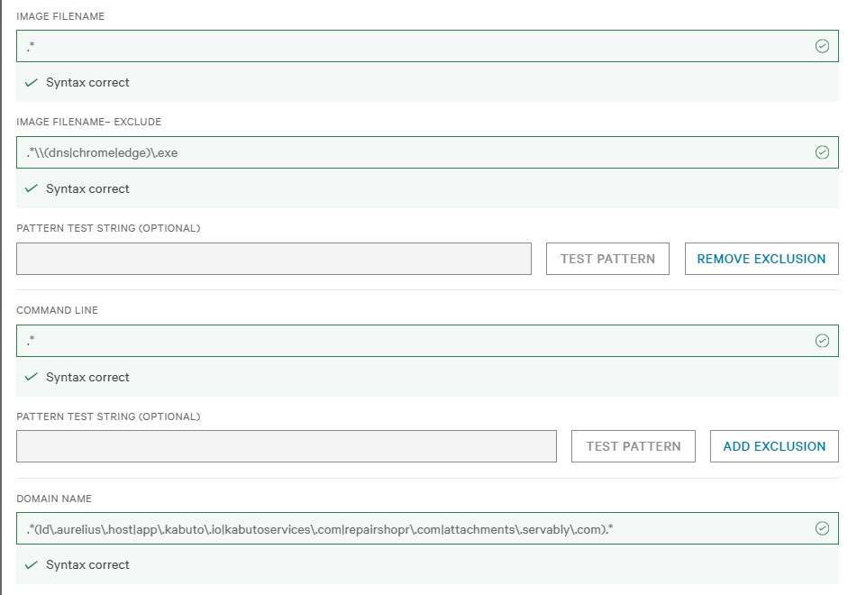
IOA

Slide 6
Ongoing Findings
Social Engineering
Persistence
Hygiene
“You have a virus, let us help.”
Gray and black
Clean up the environment
Able to catch opportunistic attacks (Malvertising).
Able to catch shadow IT and TA’s attempting persistence.
Help establish and enforce strict software allow/block policies.

Slide 7
IOA: Covert Persistence & Evasion
Threat Actors' Exploitation of Reverse Tunnels and Encrypted Services
Bypassing Network Defenses: Reverse tunnels create outbound connections, circumventing firewalls and establishing covert C2 channels for data exfiltration.
Stealthy C2 & Data Exfiltration: Abused encrypted services (e.g., Telegram) offer hidden communication for C2 and data exfiltration, blending with legitimate traffic.
Persistent & Obfuscated Access: Reverse tunnels provide persistent access despite IP changes. Legitimate-looking domains (e.g., *.ngrok.*, *.argotunnel.com) and common ports (e.g., 443) obfuscate malicious activity.

Slide 8
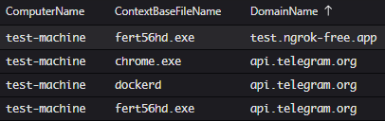
Hunting
Query: #event_simpleName=DnsRequest
|in(field="DomainName", values=[api.telegram.org,*.ngrok.app, *.ngrok.dev,*.ngrok-free.app, *.ngrok-free.dev, *.ngrok.io])
|groupBy([ComputerName,ContextBaseFileName,DomainName])

Slide 9
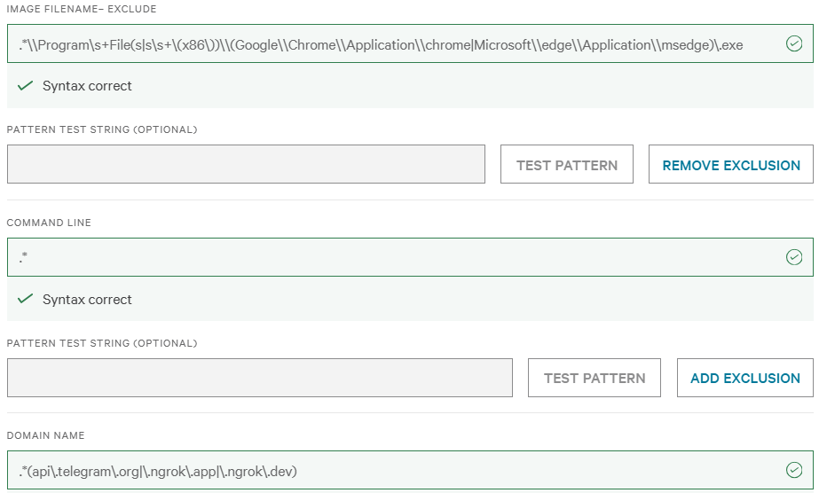
IOA

Slide 10
Ongoing Findings
Shadow IT
Graywear
Sig:Noise
Its Faster
Just keep clicking next
Low alert rate
Most findings are benign and come to people trying to accomplish a task faster.
Downloaded tools that have capabilities that are not understood by the end user.
Once exclusions are in place, noise is minimal

Slide 11
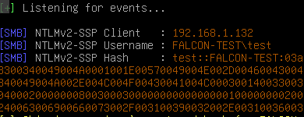
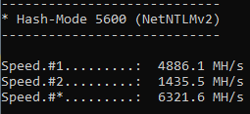
IOA: SMB to external IP.
Exploiting Authentication Weaknesses for Credential Theft
Credential Theft: External SMB connections often expose login credentials on unsecure networks, making them vulnerable to interception.
NTLM Relay Attacks: Attackers can intercept and "relay" authentication attempts to other services, gaining unauthorized access without cracking passwords.
Downgrade Attacks: Malicious actors can force SMB connections to downgrade to less secure protocols like WebDAV, enabling unauthorized file access, modification, or execution on target systems.

Slide 12
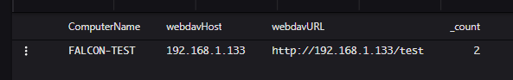
Hunting
Query: #event_simpleName=ProcessRollup2 CommandLine=/davsetcookie/i |webdavData := splitString(field=CommandLine, by=" ")
|webdavHost:=webdavData[2]
|webdavURL:=webdavData[3] | !cidr(webdavHost, subnet=["172.16.0.0/12"])
|groupBy([ComputerName,webdavHost,webdavURL])

Slide 13
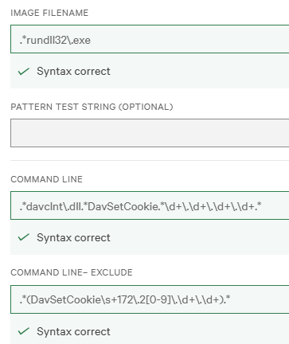
IOA

Slide 14
Ongoing Findings
Vulnerabilities
Attacks
Sig:Noise
CVE’s
SigJacking
Low alert rate
Able to catch multiple CVE’s before the CVE’s were released.
Caught external sigjacking attempts
Once exclusions are in place, noise is minimal

Slide 15
Custom IOAs Drive Stronger Security
Tangible Time Savings: We have observed a clear reduction in the time spent on resolving security tickets. By preemptively blocking non-compliant activities, we have eliminated unnecessary investigative steps, enabling our teams to work more efficiently.
Proactive Threat Hunting: Our custom IOAs act as an extended set of eyes, alerting us to anomalous behaviors that might indicate early-stage reconnaissance, lateral movement, and execution. This proactive detection significantly increases our chances of identifying and neutralizing threats before they escalate.
Improved Threat Signal-to-Noise Ratio: While initial deployment may introduce new alerts, the high fidelity of custom IOAs, when properly tuned, allows us to distinguish between benign and truly suspicious activity, ultimately improving our ability to prioritize and respond to genuine threats.
Future-Proofing Defense: This capability empowers us to rapidly adapt our defenses against new attack techniques and internal policy changes, ensuring our security posture remains robust and responsive in a dynamic threat landscape.

